Slide 1

Learning Objective
I will find common factors of two numbers.
Enter quietly, please be ready with the following on your desk:
Whiteboard
Whiteboard marker
Exercise Book
Pencil, pen, ruler and red pen
Diary
Calculator
Device – charged or borrowed from Library before maths

Slide 2
Daily Review
CFU
What is the first step?
Common multiples of two numbers are any number that appears in the times table of both of your numbers.
CFU
What is the second step?
Common Multiples of 2 and 6
CFU
Write out the times tables of the first number.
2
4
6
8
10
12
14
16
18
20
6
12
18
24
30
36
42
48
54
60
How do you find the common multiples?
Write out the times tables of the second number.
The first 3 common multiples of 2 and 6 are 6, 12 and 18.
Highlight any common numbers between the lists.
Clearly write out your answer.

Slide 3
Question
There may be more than one!!
Which of the following are common multiples of 3 and 4?
A: 2
B: 4
C: 8
D: 12
E: 20
F: 24

Slide 4
Daily Review
The Lowest Common Multiple (LCM) of two numbers is the lowest number that appears in all of the numbers’ times tables.
Lowest Common Multiple of 3 and 5
Write out the times tables of the first number.
3
6
9
12
15
5
10
15
Write out the times tables of the second number.
Highlight the first common number between the lists.
The LCM of 3 and 5 is 15.
Clearly write out your answer.

Slide 5
Daily Review
CFU
How many answers will you get for LCM?
The Lowest Common Multiple (LCM) of two numbers is the lowest number that appears in all of the numbers’ times tables.
Lowest Common Multiple of 9 and 6
Write out the times tables of the first number.
9
18
27
36
45
54
6
12
18
24
30
36
42
48
54
Write out the times tables of the second number.
The LCM of 9 and 6 is 18.
Highlight the first common number between the lists.
Clearly write out your answer.

Slide 6
Question
Which of the following is the LCM of 5 and 10?
A: 1
B: 2
C: 10
D: 5
E: 15
F: 25

Slide 7

Learning Objective
CFU
What will we learn today?
CFU
I will find common factors of two numbers.
How will you know that you are successful?
Success Criteria
At the end of the lesson, I will be able to:
Determine the divisibility of a number.
Find all of the factors of a number.
Find the highest common factor of 2 numbers.

Slide 8


Activate Prior Knowledge
VOCABULARY
Divisible – Able to be divided by a number so that the answer is a whole number
e.g. 6 is divisible by 2
(6 ÷ 2 = 3).
A quick way to determine if a number is divisible by 2 is to check if it is an even number.
Determine if the following numbers are divisible by 2:
56 98 65 37 24 39
28 40 68 334 2847

Slide 9
Activate Prior Knowledge
VOCABULARY
Divisible – Able to be divided by a number so that the answer is a whole number
e.g. 6 is divisible by 2
(6 ÷ 2 = 3).
A quick way to determine if a number is divisible by 5 is to check if the last digit is a 0 or 5.
Determine if the following numbers are divisible by 5:
50 98 65 37 24 39
28 40 68 335 2847

Slide 10
Activate Prior Knowledge
VOCABULARY
Divisible – Able to be divided by a number so that the answer is a whole number
e.g. 6 is divisible by 2
(6 ÷ 2 = 3).
A quick way to determine if a number is divisible by 3 is to check if the digits add up to a number in the 3 times table.
Determine if the following numbers are divisible by 3:
56
98
63
5 + 6 = 11
558
329
720
5 + 5 + 8 = 18
11 is NOT in the 3x table.
18 IS in the 3x table.
9 + 8 = 17
3 + 2 + 9 = 14
17 is NOT in the 3x table.
14 is NOT in the 3x table.
6 + 3 = 9
7 + 2 + 0 = 9
9 IS in the 3x table.
9 IS in the 3x table.

Slide 11
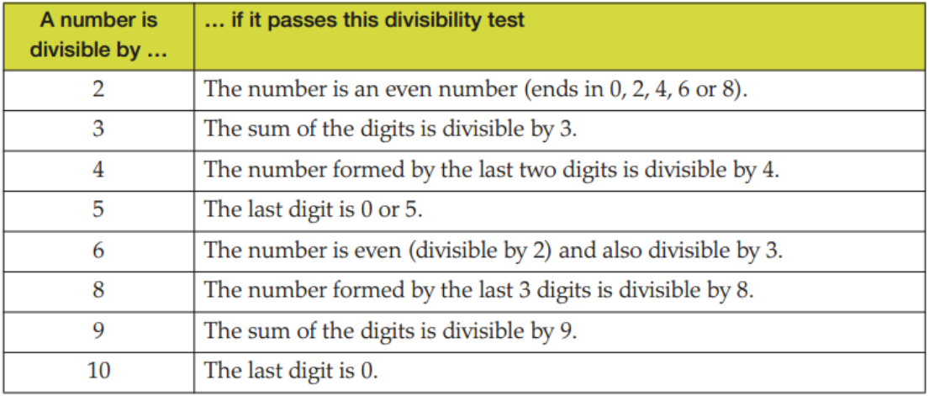
Relevance
What you have just demonstrated are the most common rules of the divisibility tests. The other rules are shown below:
These tests will help you to quickly determine if a number is divisible by another.
This will also help you identify the factors of a number.

Slide 12
Question
Which of the following have 5 as a factor?
A: 22
B: 20
C: 15
D: 567
E: 1505
F: 2 543 375

Slide 13
Question
Which of the following have 2 as a factor?
A: 22
B: 20
C: 15
D: 567
E: 1505
F: 2 543 375

Slide 14
Concept Development
CFU
What is a factor?
A factor is a number that divides exactly into another number (leaves no remainder or decimal).
CFU
Why don’t factors go on forever?
Unlike multiples, there are a limited number of factors. This is because you can only divide up a number a certain number of times before it becomes too small (less than 1).
What are the factors of 4?
What are the factors of 6?
1, 2, 4
1, 2, 3, 6
The first factor is always 1
The last factor is always the original number

Slide 15
Skill Development
Think, Pair, Share
Why is it easier to think of factors in pairs?
To ensure you find all of the factors of a number, it is easier to think of them in pairs.
1
2
2
4
__ x __ = 4
1
, ,
2
4
The factors of 4 are ________.

Slide 16
Skill Development
Hint
Think of factors in pairs.
Find the factors of the numbers below:
Factors of 12
Factors of 20
1
2
3
4
12
6
4
3
1, 2, 3, 4, 6, 12
1, 2, 4, 5, 10, 20
Whiteboards
Factors of 24
Factors of 32
1, 2, 3, 4, 6, 8, 12, 24
1, 2, 4, 8, 16, 32

Slide 17
Skill Development
For larger and more difficult numbers, work your way up from 1, asking “is it divisible?”
1, 3, 5, 15, 25, 75
The factors of 75 are ________________.
Is it divisible by 1?
Yes, 1 x 75 = 75
Is it divisible by 2?
No
Is it divisible by 3?
Yes, 3 x 25 = 75
Is it divisible by 4?
No
Is it divisible by 5?
Yes, 5 x 15 = 75
Is it divisible by 6?
No
Is it divisible by 7?
No
Is it divisible by 8?
No
Is it divisible by 9?
No

Slide 18
Skill Development
CFU
Why is 1 always a common factor?
Just like common multiples, a common factor divides exactly into two or more numbers.
Write out the factors of the first number.
Common Factors of 9 and 6
Write out the factors of the second number.
1
3
9
1
2
3
6
Highlight the common numbers between the lists.
The common factors of 9 and 6 are 1 and 3.
Clearly write out your answer.

Slide 19
Skill Development
CFU
Why is 1 always a common factor?
Just like common multiples, a common factor divides exactly into two or more numbers.
Write out the factors of the first number.
Common Factors of 4 and 20
1
2
4
1
2
4
5
10
20
Write out the factors of the second number.
Highlight the common numbers between the lists.
Clearly write out your answer.
The common factors of 4 and 20 are 1, 2 and 4.

Slide 20
Question
Which of the following are common factors of 12 and 20?
A: 1
B: 2
C: 3
D: 4
E: 10
F: 12

Slide 21
Skill Development
CFU
What is a Highest Common Factor?
It is often useful to find the highest common factor (HCF) of a pair of numbers. This is also known as the greatest common devisor (GCD).
Write out the factors of the first number.
Highest Common Factor of 12 and 18
1
2
3
4
6
12
1
2
3
6
9
18
Write out the factors of the second number.
Highlight the largest number in common between the lists.
Clearly write out your answer.
The highest common factor of 12 and 18 is 6.

Slide 22
Question
Which of the following is the HCF of 6 and 18?
A: 1
B: 2
C: 3
D: 4
E: 6
F: 18

Slide 23
Guided Practice
Whiteboards
Find the factors of:
Find the HCF of:
16
18
28
15 and 12
18 and 24
32 and 24
1, 2, 4, 8, 16
3
1, 2, 3, 6, 9, 18
6
1, 2, 4, 7, 14, 28
8

Slide 24
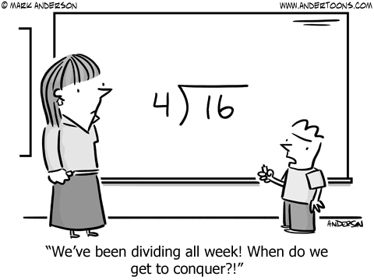
Skill Closure
What have we learnt today?
Lesson Objectives:
I will find common factors of two numbers.
  What is a factor?
A number that divides exactly into another number.

Slide 25


Independent Practice
Mathematics Page Layout
Open your textbooks to:
Chapter 2.1
Questions: 1, 2, 5, 14

